Slide 1
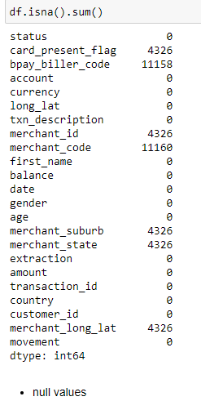
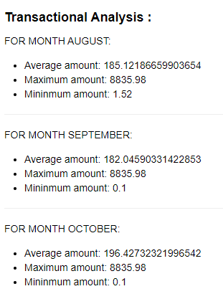
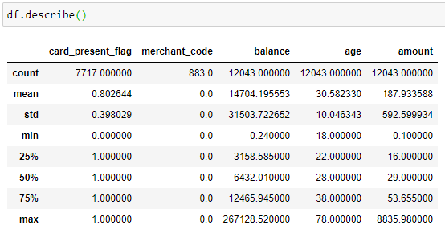
Start by doing some basic checks – 1. are there any data issues? Does the data need to be cleaned? 2 . Gather some interesting overall insights about the data. For example -- what is the average transaction amount? How many transactions do customers make each month, on average? 3. Segment the dataset by transaction date and time. Visualise transaction volume and spending over the course of an average day or week. Consider the effect of any outliers that may distort your analysis. For a challenge – what insights can you draw from the location information provided in the dataset?
1. Data has missing values, ie data need to be cleaned
2. Average transactions of customers make
each month
3. All the average , minimum, maximum values
of the amount transactions can be viewed by
describe method.

Slide 2
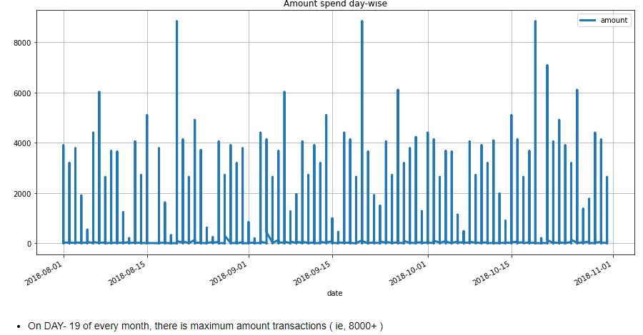
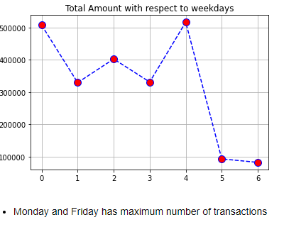
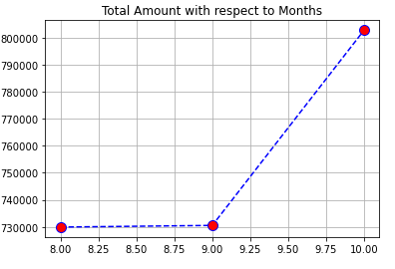
With respect to weekdays, Monday and Friday customers do most of the transactions.
With respect to months, On October we have maximum numbers of transactions done.
On 19th day of each month(aug, sept, oct) we have maximum amount of transactions.

Slide 3
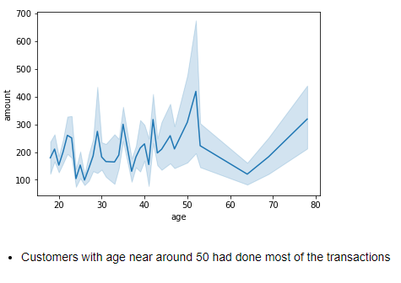
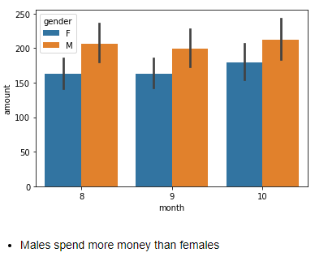
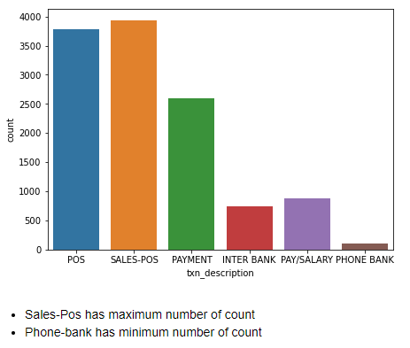
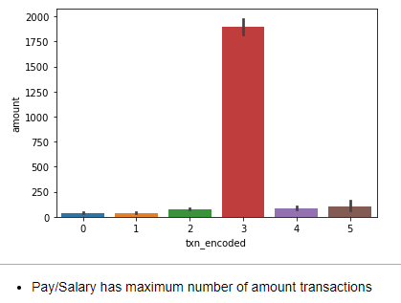
Customers with age around 50 had done many amount transactions
With respect to gender, Male customers used to do maximum amount transactions.
With respect to txn_transactions, we have maximum observations in Sales-Pos but, the maximum amount of transactions are done in Pay/Salary.

Slide 4
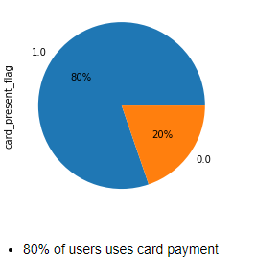
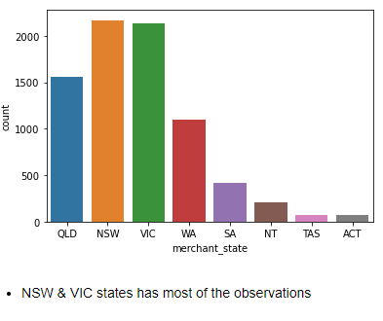
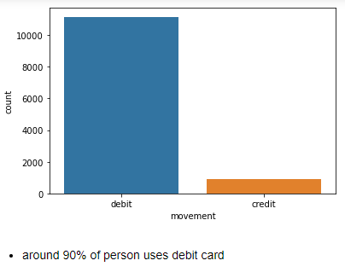
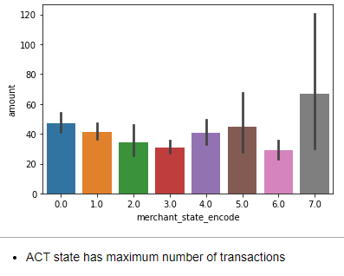
With respect to card payments, Around 80% of the users pay via credit card/ Debit card .
Inside that 80% customers who uses card for payment, Around 90% of customers uses debit card.
NSW & VIC has maximum number of observations, but ACT state has maximum number of amount transactions

